Slide 1
COUPON REDEMPTION &
CUSTOMER BEHAVIOR
Data Mining & Warehousing (DMW) Project
Tools: Weka | Jupyter (Python) | Power BI
Presented By Nandini Maurya
SY BSC

Slide 2
Introduction
Retailers issue coupons to boost sales and loyalty
Not every coupon gets used redemption rate is low
Data mining helps find who redeems and why
Project: Predict Coupon Redemption and Analyse Customer Behavior
2

Slide 3
Dataset Used
Overview
Name: Predicting Coupon Redemption
Source: Kaggle
7 CSV files (train, test, campaign, transactions, items, coupon, demography)
Train records: 78,369
Target: redemption_status (0 = No, 1 = Yes)
Python file: DMW Coupon Redemption (Jupyter Notebook)
Key Attributes
total_quantity
total_sales_value
transaction_count
total_other_discount
total_coupon_discount
Also: campaign_type, age_range, campaign_id
3

Slide 4
Problem Statement
Problem
Coupon redemption is very low
Hard to know which customers will redeem a coupon
Marketing spend is wasted on non-redeemers
Goal
Predict redemption status for each customer
Understand behavior by age, campaign type & campaign
4

Slide 5
Algorithm Used: Random Forest
Ensemble of many decision trees (bagging)
Weka setting: 100 trees, 10-fold cross-validation
Each tree votes and the majority vote is final class
Handles numeric attributes well
Reduces overfitting vs a single tree
5

Slide 6
How Does It Solve the Problem?
Approach
Use data make predictions
Identifies more likely to redeem
Helps target likely customers
Supports effective decisions making
6

Slide 7
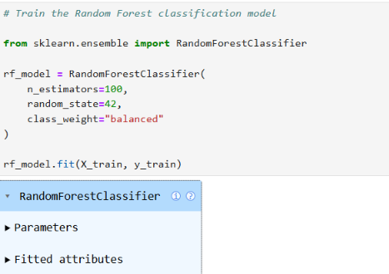
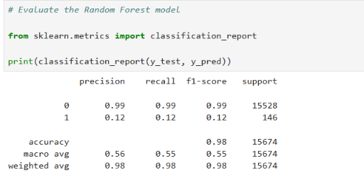
Python (Jupyter) Implementation
Model training code
Classification report
File: Coupon Redemption ( 7 CSVs, cleaned & used Random Forest )
Random Forest: 100 trees, class_weight = balanced, 80/20 split
Shown: 98% accuracy but class 1 recall only 0.12 and refined model raised recall to 0.68
7

Slide 8
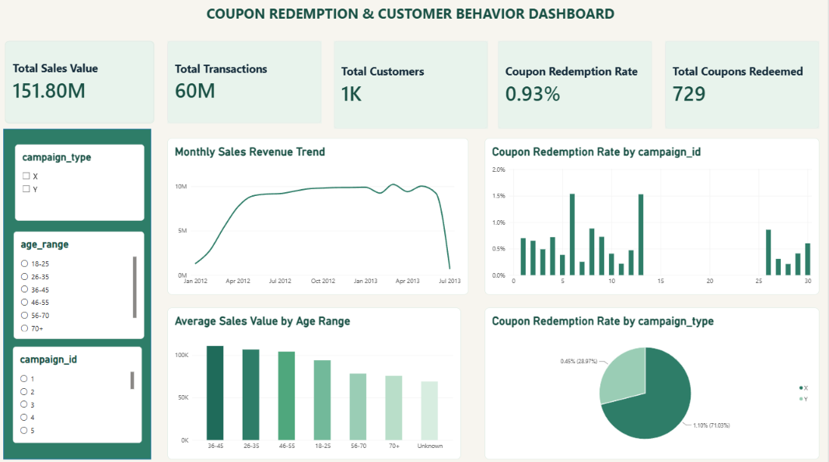
Power BI Dashboard
Sales: 151.80M
Transactions: 60M
Customers: 1K
Redemption rate: 0.93%
Coupons redeemed: 729
Campaign type X: 1.10% vs Y: 0.45%
Ages 36-45 spend the most
8

Slide 9
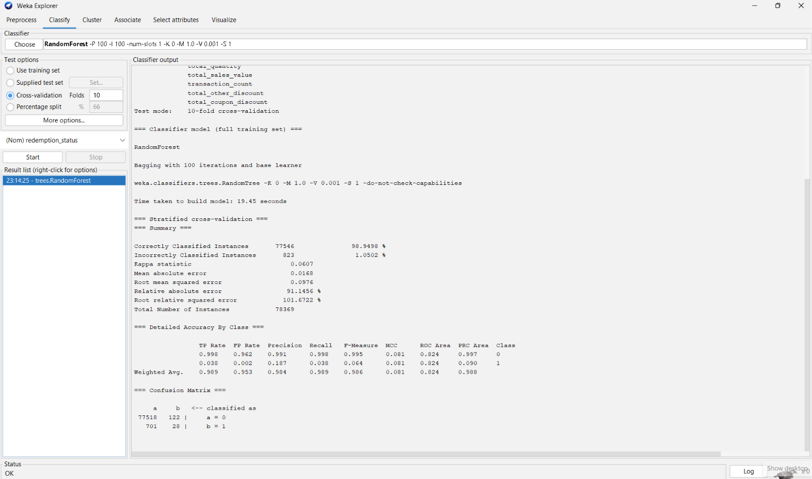
Weka Output (Random Forest)
Weka Results
Accuracy: 98.95%
ROC Area: 0.824
Kappa: 0.0607
Class 1 recall: 0.038 (only 28 of 729 caught)
Reason: data heavily imbalanced (729 vs 77,640)
Random Forest, 100 trees
10-fold cross-validation
Correct: 77,546 (98.95%)
Incorrect: 823 (1.05%)
Build time: 19.45 sec
9

Slide 10
Conclusion
Random Forest achieved 98.95% accuracy
data is imbalanced
Redemption rate is very low (0.93%)
Campaign type X performs better than Y
Python refined model: class 1 recall 0.12 , 0.68
10

Slide 11
References
Kaggle – Predicting Coupon Redemption
Weka – Machine Learning Group, University of Waikato
Breiman, L. (2001). Random Forests. Machine Learning, 45(1)
Microsoft Power BI Documentation
Jupyter / Python (pandas, scikit-learn) documentation
11

Slide 12
THANK YOU

